Slide 1
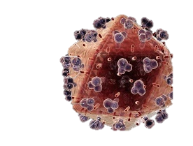
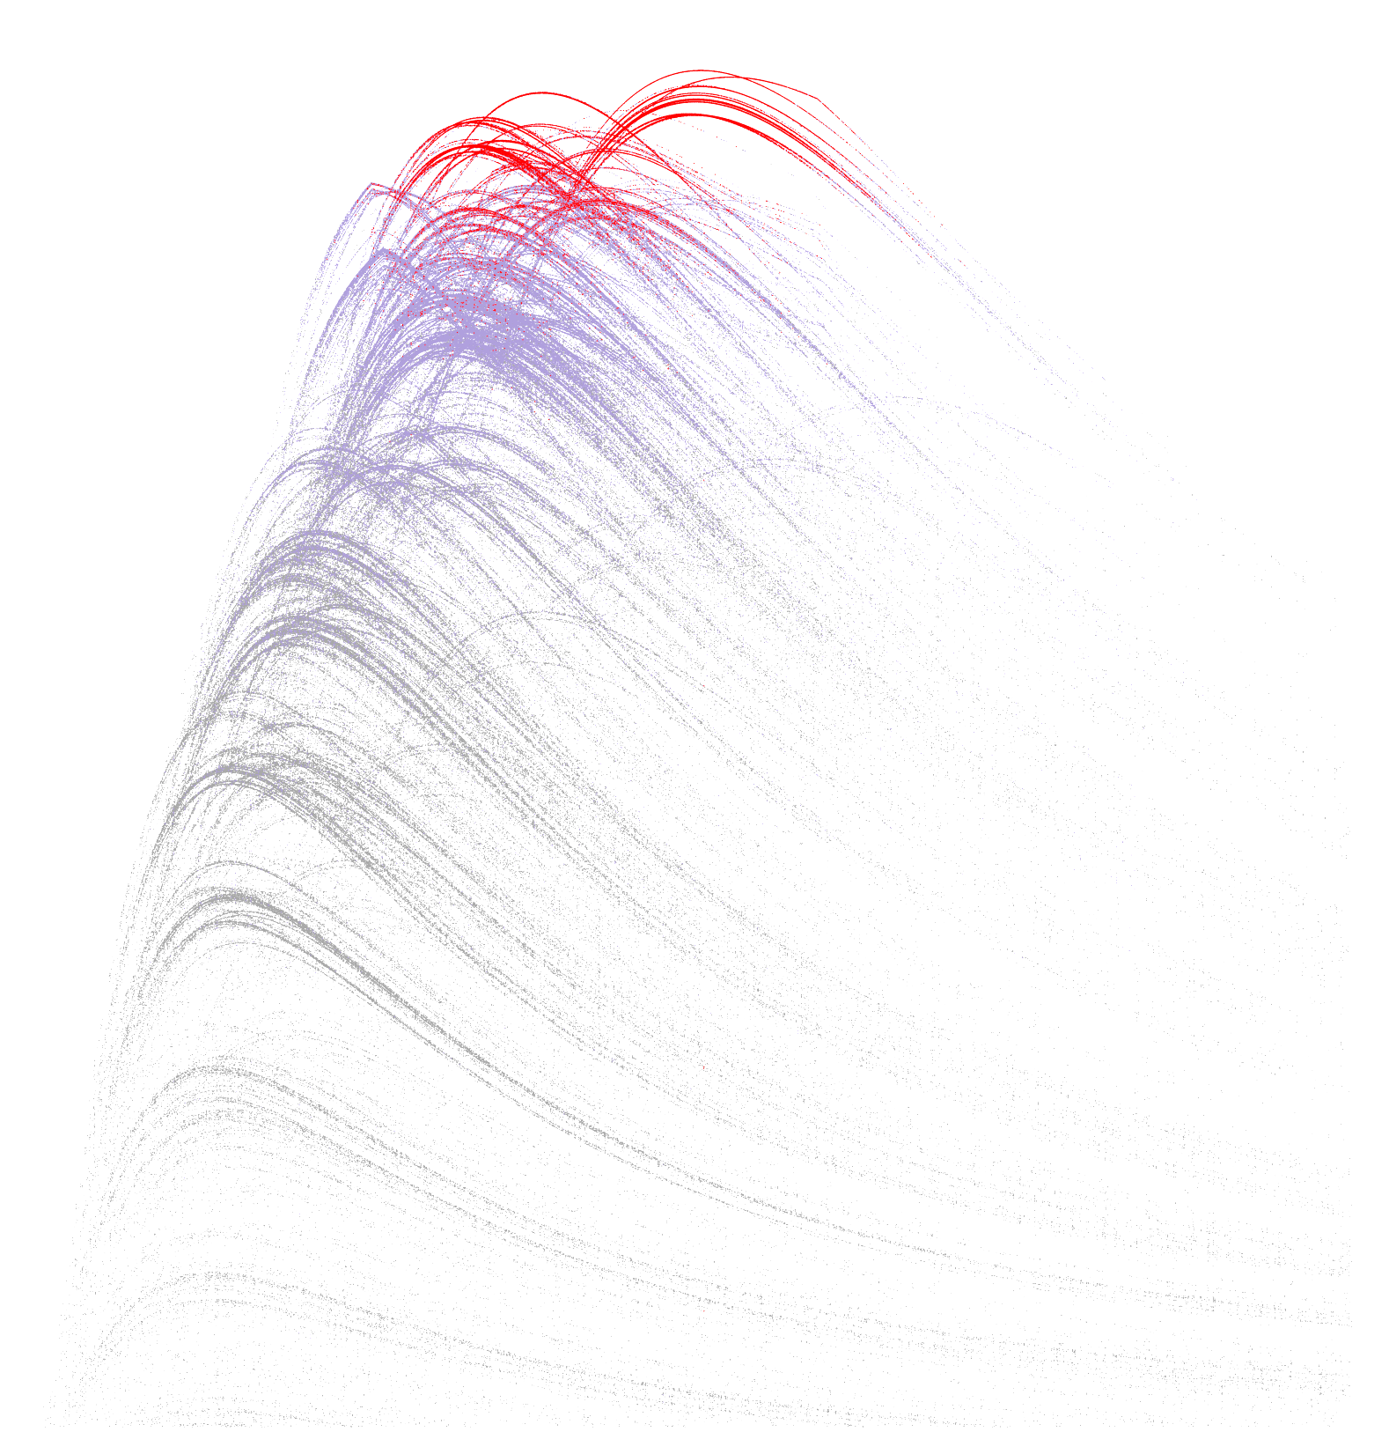
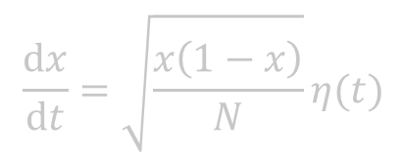
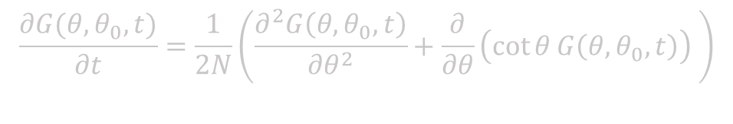
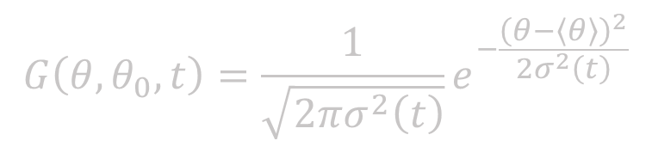
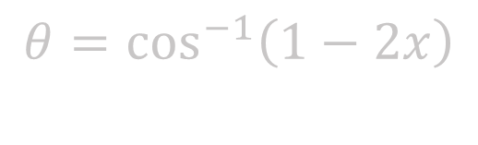
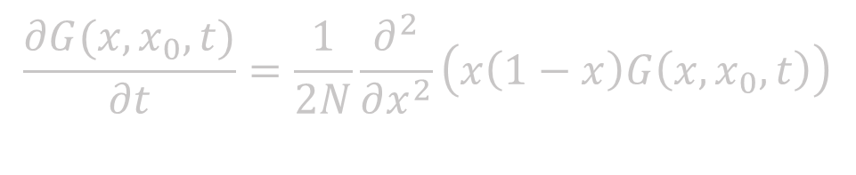
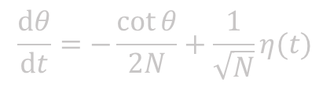
Evolutionary modelling
$$θ=\cos^{−1}\left(1−2x\right)$$
$$\frac{∂G(x,x_{0},t)}{∂t}=\frac{1}{2N}\frac{∂^{2}}{∂x^{2}}\left(x\left(1−x\right)G\left(x,x_{0},t\right)\right)$$
$$\frac{∂G(θ,θ_{0},t)}{∂t}=\frac{1}{2N}\left(\frac{∂^{2}G\left(θ,θ_{0},t\right)}{∂θ^{2}}+\frac{∂}{∂θ}\left(\cot{θ}G\left(θ,θ_{0},t\right)\right) \right)$$
Bhavin S Khatri
bkhatri@imperial.ac.uk
$$\frac{dθ}{dt}=−\frac{\cot{θ}}{2N}+\frac{1}{\sqrt{N}}η(t)$$
$$\frac{dx}{dt}=\sqrt{\frac{x\left(1−x\right)}{N}}η(t)$$
$$G\left(θ,θ_{0},t\right)=\frac{1}{\sqrt{2πσ^{2}\left(t\right)}}e^{−\frac{{\left(θ−〈θ〉\right)}^{2}}{2σ^{2}\left(t\right)}}$$

Slide 2
What is Evolution?
Life: Reproducing organism carrying information, e.g. in DNA, about how to survive in an “environment”
Selection: those organisms that have the best information about surviving/reproduce best/fastest (survival of the fittest)
Mutation: random changes in information
Mutation + Selection→ adaptation to best information
Random Genetic Drift: Stochasticity due to finite size of populations → sometimes populations adapt to sub-optimal information

Slide 3
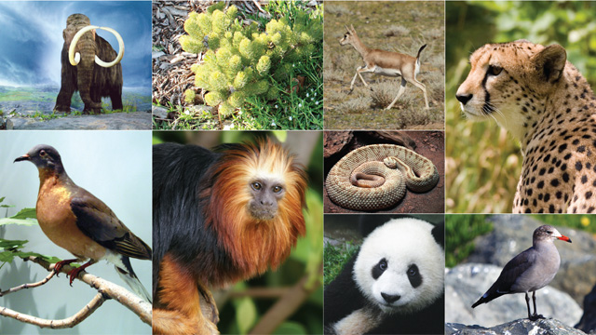
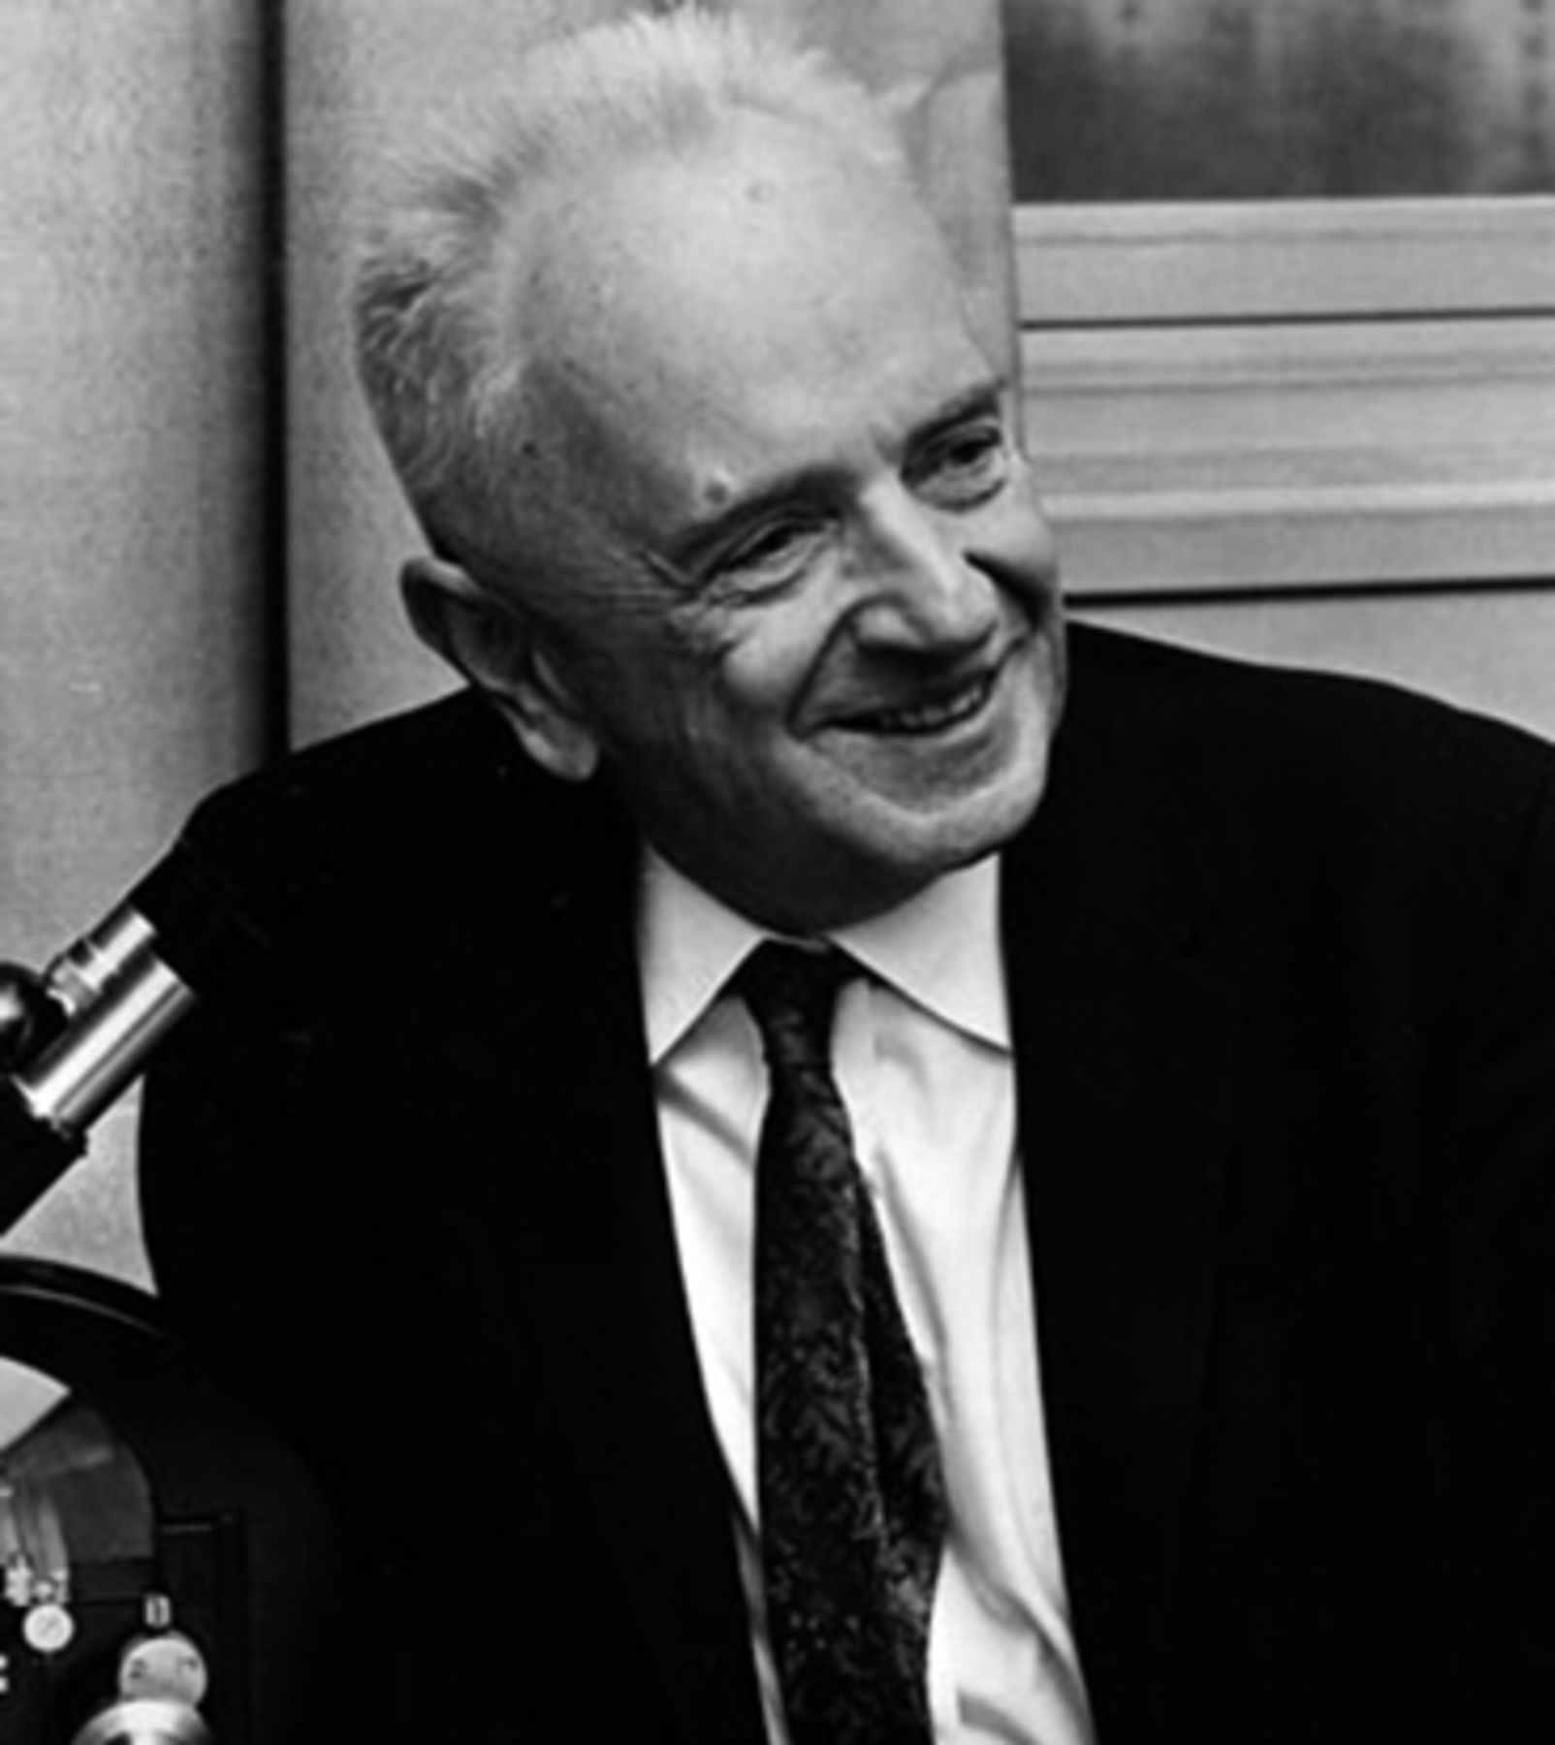
Diversity of life and phenotypic form?
“Nothing in Biology Makes Sense Except in the Light of Evolution”
Theodosius Dobzhansky,
The American Biology Teacher, 1973

Slide 4
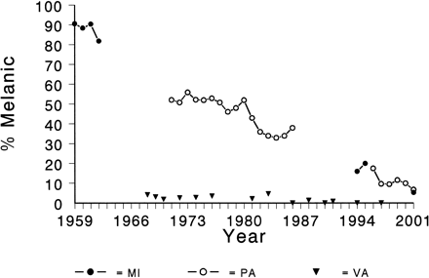
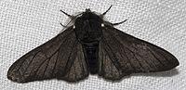
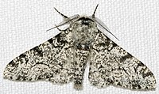
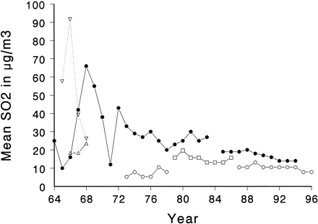
Population genetics
Study of evolution of genes in populations
B. S. Grant L. L. Wiseman
Journal of Heredity, Volume 93, Issue 2, 1 March 2002, Pages 86–90

Slide 5
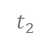
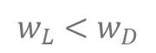
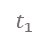
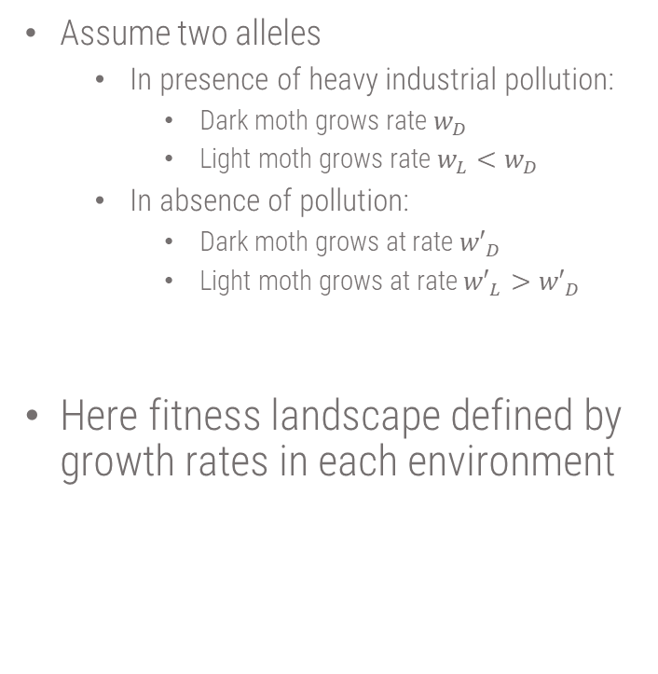
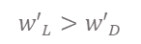
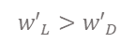
How could we model this evolution?
Pollution
Assume two alleles
In presence of heavy industrial pollution:
Dark moth grows rate $w_{D}$
Light moth grows rate $w_{L}<w_{D}$
In absence of pollution:
Dark moth grows at rate ${w′}_{D}$
Light moth grows at rate ${w′}_{L}>{w′}_{D}$
Here fitness landscape defined by growth rates in each environment
$$t_{1}$$
$$t_{2}$$
Freq of dark moth
time
$$w_{L}<w_{D}$$
$${w′}_{L}>{w′}_{D}$$
$${w′}_{L}>{w′}_{D}$$
time

Slide 6


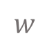
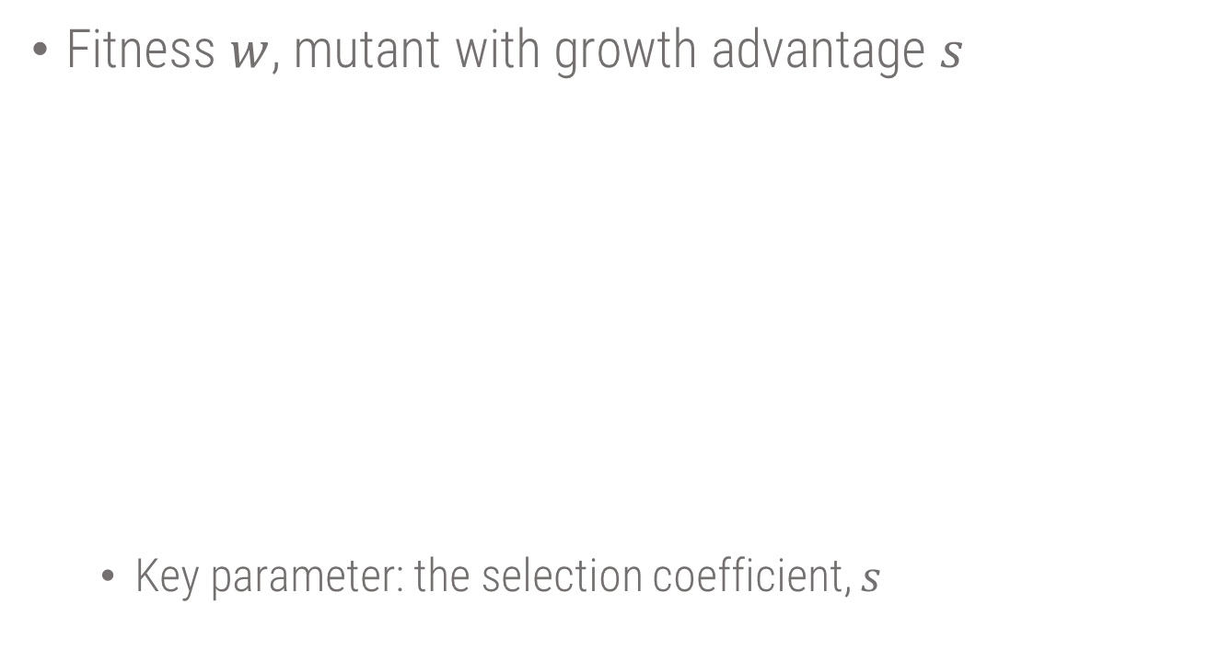
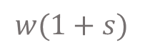
Basic evolutionary force: selection
Fitness $w$, mutant with growth advantage $s$
Key parameter: the selection coefficient, $s$
$$w$$
$$w(1+s)$$

Slide 7
Basic evolutionary force: Mutation

Slide 8
Basic evolutionary force: Mutation

Slide 9
Basic evolutionary force: Mutation

Slide 10
Basic evolutionary force: Mutation

Slide 11
Basic evolutionary force: Mutation

Slide 12
Basic evolutionary force: Mutation

Slide 13
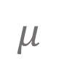

Basic evolutionary force: Mutation
$$μ$$
$$μ$$

Slide 14
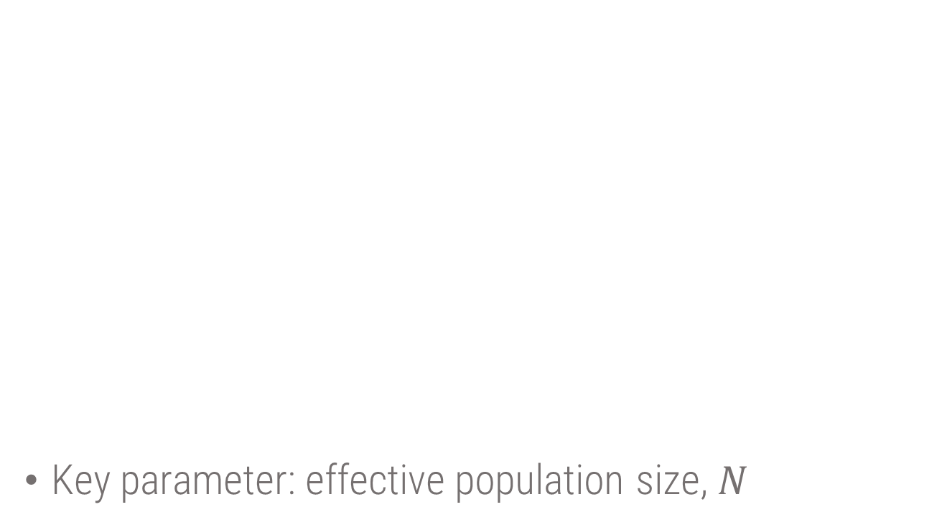
Basic evolutionary force: Random genetic drift
Key parameter: effective population size, $N$
Notes:
Comment on physics definition of drift. And in actuality that it can be shown that genetic drift should really be called genetic flux, as discussed in my paper

Slide 15

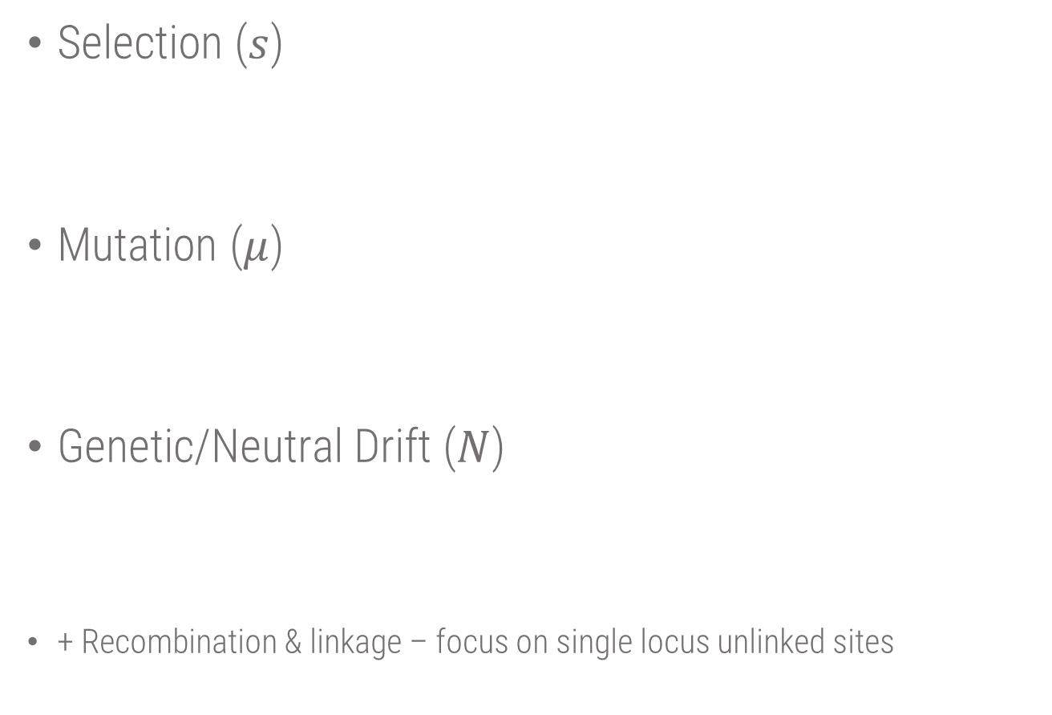
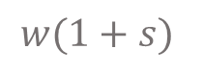
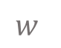

3 basic evolutionary forces
Selection ($s$)
Mutation ($μ$)
Genetic/Neutral Drift ($N$)
+ Recombination & linkage – focus on single locus unlinked sites
$$w$$
$$w(1+s)$$
$$μ$$
$$μ$$

Slide 16
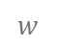
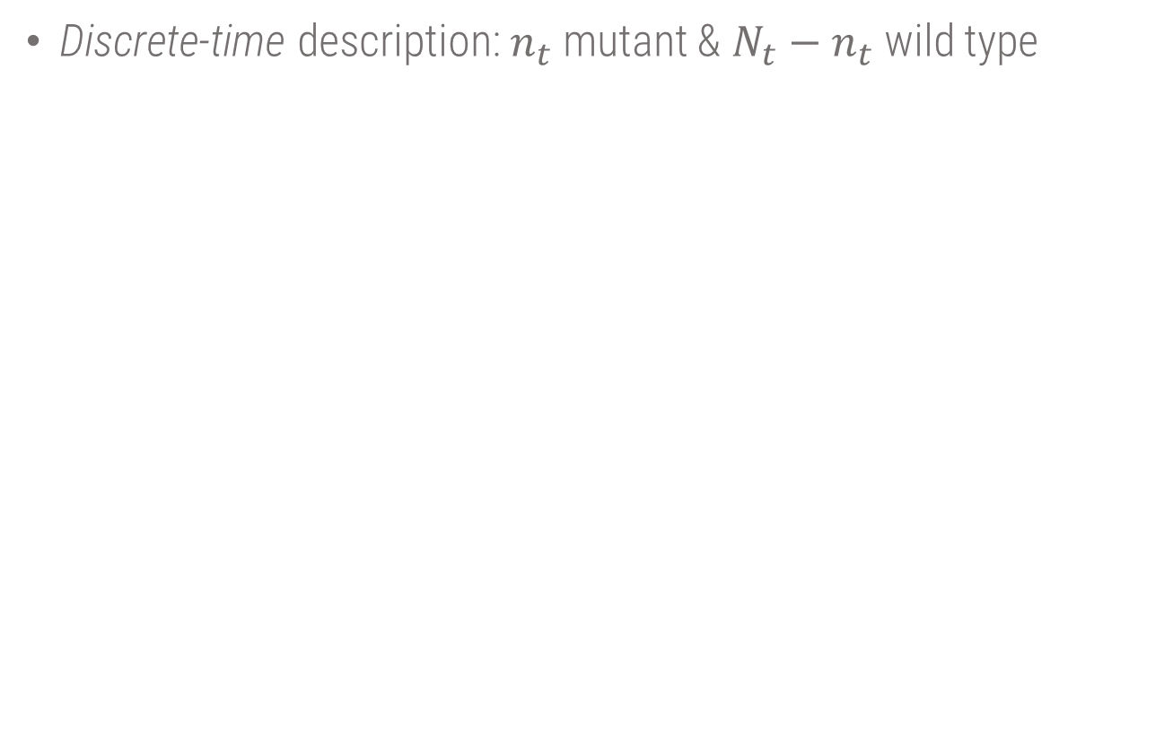
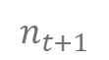
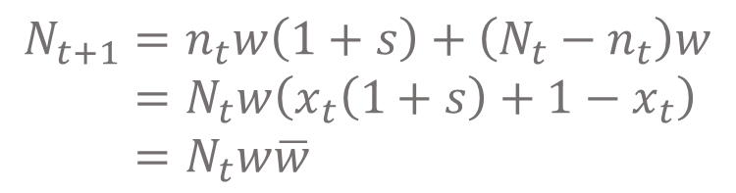
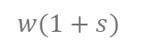
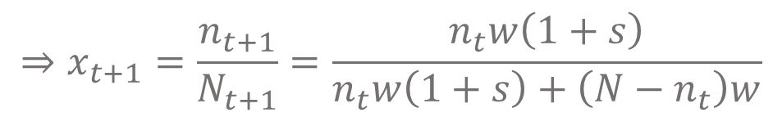
Selection: two alleles
$$w$$
$$w(1+s)$$
Discrete-time description: $n_{t}$ mutant & $N_{t}−n_{t}$ wild type
$$n_{t+1}$$
$$N_{t+1}=n_{t}w\left(1+s\right)+\left(N_{t}−n_{t}\right)w \\ =N_{t}w\left(x_{t}\left(1+s\right)+1−x_{t}\right) \\ =N_{t}w\overline{w}$$
$$⇒x_{t+1}=\frac{n_{t+1}}{N_{t+1}}=\frac{n_{t}w\left(1+s\right)}{n_{t}w\left(1+s\right)+\left(N−n_{t}\right)w}$$

Slide 17
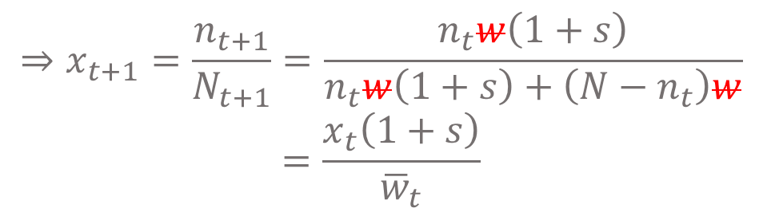
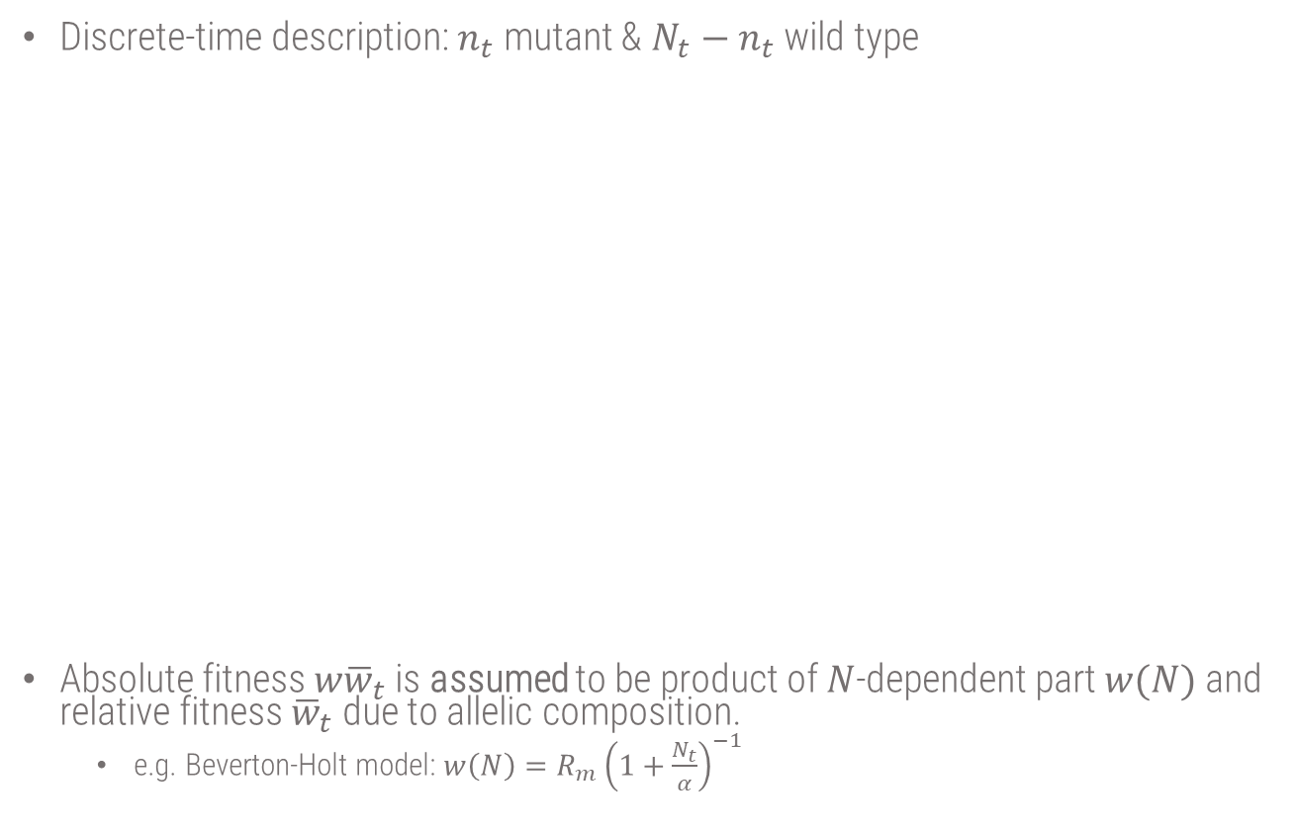
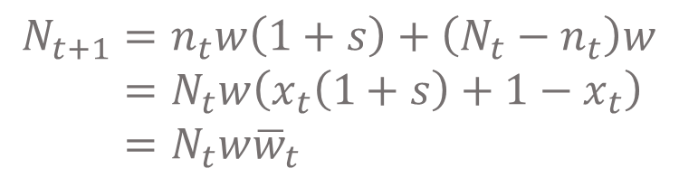
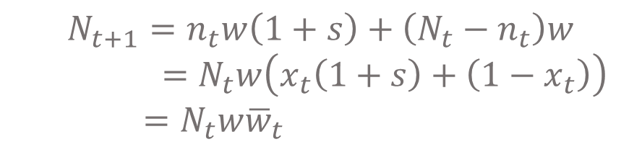
Selection: two alleles
$$w$$
$$w(1+s)$$
Discrete-time description: $n_{t}$ mutant & $N_{t}−n_{t}$ wild type
Absolute fitness $w{\overline{w}}_{t}$ is assumed to be product of $N$-dependent part $w(N)$ and relative fitness ${\overline{w}}_{t}$ due to allelic composition.
e.g. Beverton-Holt model: $w\left(N\right)=R_{m}{\left(1+\frac{N_{t}}{α}\right)}^{−1}$
$$n_{t+1}$$
$$N_{t+1}=n_{t}w\left(1+s\right)+\left(N_{t}−n_{t}\right)w \\ =N_{t}w\left(x_{t}\left(1+s\right)+1−x_{t}\right) \\ =N_{t}w{\overline{w}}_{t}$$
$$⇒x_{t+1}=\frac{n_{t+1}}{N_{t+1}}=\frac{n_{t}w\left(1+s\right)}{n_{t}w\left(1+s\right)+\left(N−n_{t}\right)w}$$
$$=\frac{x_{t}\left(1+s\right)}{{\overline{w}}_{t}}$$

Slide 18
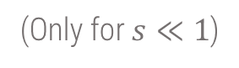
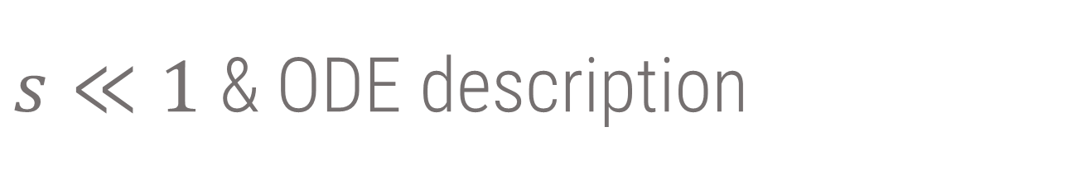
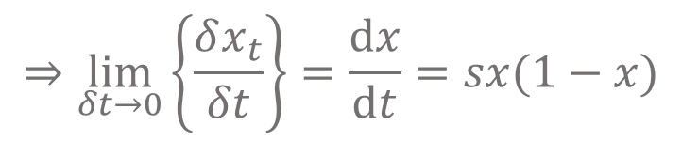
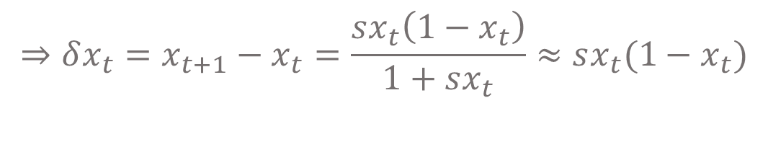
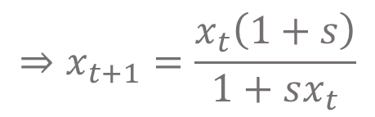
$s≪1$ & ODE description
$${\overline{w}}_{t}=x_{t}\left(1+s\right)+\left(1−x_{t}\right)=1+sx_{t}$$
$$⇒x_{t+1}=\frac{x_{t}\left(1+s\right)}{1+sx_{t}}$$
$$⇒δx_{t}=x_{t+1}−x_{t}=\frac{sx_{t}\left(1−x_{t}\right)}{1+sx_{t}}≈sx_{t}(1−x_{t})$$
$$⇒\lim_{δt→0}\left\{\frac{δx_{t}}{δt}\right\}=\frac{dx}{dt}=sx(1−x)$$
(Only for $s≪1$)
Basically logistic ODE with carrying capacity $K=1$ and growth rate $v=s$

Slide 19
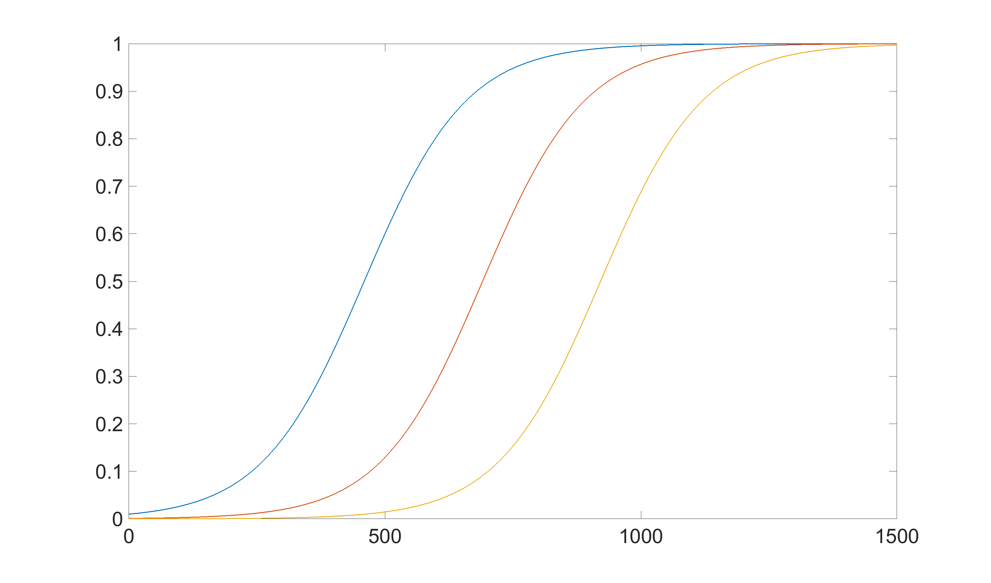
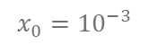
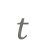
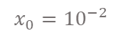
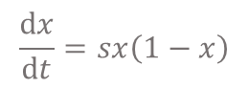
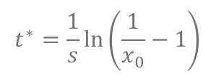
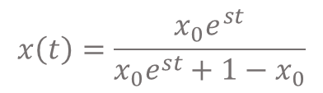



Dynamics of selection
$$\frac{dx}{dt}=sx\left(1−x\right)$$
$$x\left(t\right)=\frac{{x_{0}e}^{st}}{x_{0}e^{st}+1−x_{0}}$$
$$x_{0}={10}^{−2}$$
$$x_{0}={10}^{−3}$$
$$x_{0}={10}^{−4}$$
$$x$$
$$t^{∗}=\frac{1}{s}\ln\left(\frac{1}{x_{0}}−1\right)$$
$$t^{∗}$$
$$t$$

Slide 20








Dynamics of selection
$$\frac{dx}{dt}=sx\left(1−x\right)$$
$$x\left(t\right)=\frac{{x_{0}e}^{st}}{x_{0}e^{st}+1−x_{0}}$$
$$s=1$$
$$s=0.1$$
$$s=0.01$$
$$s=0.001$$
$$x$$
$$t^{∗}=\frac{1}{s}\ln\left(\frac{1}{x_{0}}−1\right)$$
$$t$$
Notes:
One is exact discrete and the other is ODE solution!

Slide 21










Dynamics of mutation (deterministic)
$$μ$$
$$\frac{dx}{dt}=−νx+μ\left(1−x\right)$$
$$ν$$
$$x$$
$$x^{∗}=\frac{μ}{μ+ν}$$
$$x=x^{∗}+\left(x_{0}−x^{∗}\right)e^{−\left(μ+ν\right)t}$$
$$μ={10}^{−3}$$
$$ν=2μ$$
$$t$$

Slide 22










Dynamics of mutation (deterministic)
$$μ$$
$$ν$$
$$μ={10}^{−2}$$
$$μ={10}^{−3}$$
$$ν=2μ$$
$$x$$
$$\frac{dx}{dt}=−μx+ν\left(1−x\right)$$
$$x^{∗}=\frac{μ}{μ+ν}$$
$$x=x^{∗}+\left(x_{0}−x^{∗}\right)e^{−\left(μ+ν\right)t}$$
$$t$$

Slide 23
Deterministic to Stochastic evolutionary dynamics
Key concept exact predictability vs probability distributions

Slide 24



Deterministic to Stochastic evolutionary dynamics
Wright-Fisher simulations of genetic drift and selection ($N=100,s=0.1,x_{0}=0.1$
$$x\left(t\right)=\frac{{x_{0}e}^{st}}{x_{0}e^{st}+1−x_{0}}$$

Slide 25


Deterministic to Stochastic evolutionary dynamics
Wright-Fisher simulations of genetic drift and selection ($N=1000,s=0.1,x_{0}=0.1$
$$x\left(t\right)=\frac{{x_{0}e}^{st}}{x_{0}e^{st}+1−x_{0}}$$

Slide 26









Random Genetic Drift (Wright-Fisher model)
No selection, no mutation
Sewall Wright
Ronald Fisher
$$N=8$$
$$n_{t+1}=2 ⇒p\left(2 | 3\right)=\left(\begin{matrix}N \\ 2\end{matrix}\right){\left(\frac{3}{N}\right)}^{2}{\left(1−\frac{3}{N}\right)}^{N−2}$$
$$N$$
With replacement
$$n_{t+1}=0 ⇒p\left(0 | 3\right)=\left(\begin{matrix}N \\ 0\end{matrix}\right){\left(\frac{3}{N}\right)}^{0}{\left(1−\frac{3}{N}\right)}^{N}$$
$$n_{t}=3$$

Slide 27












Random Genetic Drift (Wright-Fisher model)
No selection, no mutation
Sewall Wright
Ronald Fisher
$$N$$
$$N=12$$
$$p\left(n_{t+1} | n_{t}\right)=\left(\begin{matrix}N \\ n_{t+1}\end{matrix}\right){\left(\frac{n_{t}}{N}\right)}^{n_{t+1}}{\left(\frac{N−n_{t}}{N}\right)}^{N−n_{t+1}}$$
$$p(n_{t+1}=6|n_{t}=4)$$
$$p(n_{t+1}|n_{t})$$
$${⟨n}_{t+1}⟩=n_{t}$$
$$\sqrt{\left\langle \left\langle n_{t+1}^{2}\right\rangle \right\rangle }$$
$$=N\left(\frac{n_{t}}{N}\right)\left(\frac{N−n_{t}}{N}\right)$$
$$⟨⟨n_{t+1}^{2}⟩⟩$$
Binomial distribution
$$n_{t+1}$$
$$n_{t}=4$$

Slide 28









Random Genetic Drift (Wright-Fisher model)
No selection, no mutation
Sewall Wright
Ronald Fisher
$$N$$
$$N=12$$
$$p\left(x_{t+1} | x_{t}\right)=\left(\begin{matrix}N \\ {Nx}_{t+1}\end{matrix}\right)x_{t}^{Nx_{t+1}}{\left(1−x_{t}\right)}^{N(1−x_{t+1})}$$
$$p(x_{t+1}=\frac{6}{12}|x_{t}=\frac{4}{12})$$
$$\left\langle x_{t+1}\right\rangle =\frac{{⟨n}_{t+1}⟩}{N}=x_{t}$$
$$p(x_{t+1}|x_{t})$$
$$\left\langle ⟨x_{t+1}^{2}⟩\right\rangle =\frac{⟨⟨n_{t+1}^{2}⟩⟩}{N^{2}}$$
$$=\frac{x_{t}\left(1−x_{t}\right)}{N}$$
Binomial distribution
$$x_{t+1}$$
$$x_{t}=4/12$$

Slide 29


Random Genetic Drift (Wright-Fisher model)
No selection, no mutation
Sewall Wright
Ronald Fisher
$$N$$
$$N=100$$
$$p\left(x_{t+1} | x_{t}\right)=\left(\begin{matrix}N \\ {Nx}_{t+1}\end{matrix}\right)x_{t}^{Nx_{t+1}}{\left(1−x_{t}\right)}^{N(1−x_{t+1})}$$
$$\left\langle x_{t+1}\right\rangle =\frac{{⟨n}_{t+1}⟩}{N}=x_{t}$$
$$p(x_{t+1}|x_{t})$$
$$\left\langle ⟨x_{t+1}^{2}⟩\right\rangle =\frac{⟨⟨n_{t+1}^{2}⟩⟩}{N^{2}}$$
$$=\frac{x_{t}\left(1−x_{t}\right)}{N}$$
Binomial distribution
$$x_{t+1}$$

Slide 30



Random Genetic Drift (Wright-Fisher model)
No selection, no mutation
Sewall Wright
Ronald Fisher
$$N$$
$$N=1000$$
As $N$ increases change in frequency between
generations becomes smaller
$$p\left(x_{t+1} | x_{t}\right)=\left(\begin{matrix}N \\ {Nx}_{t+1}\end{matrix}\right)x_{t}^{Nx_{t+1}}{\left(1−x_{t}\right)}^{N(1−x_{t+1})}$$
$$\left\langle x_{t+1}\right\rangle =\frac{{⟨n}_{t+1}⟩}{N}=x_{t}$$
$$p(x_{t+1}|x_{t})$$
$$\left\langle ⟨x_{t+1}^{2}⟩\right\rangle =\frac{⟨⟨n_{t+1}^{2}⟩⟩}{N^{2}}$$
$$=\frac{x_{t}\left(1−x_{t}\right)}{N}$$
Binomial distribution
$$x_{t+1}$$

Slide 31
Drift demo
Nature of drift
N=10, x0=0.5, s=0, mu=0
DriftSelectionDemo(N,x0,s,mu,delay)

Slide 32







Dynamics of drift
$$〈{\left(x_{t+1} −x_{t}\right)}^{2}〉=\frac{x_{t}\left(1−x_{t}\right)}{N}$$
$$\left\langle x_{t+1}\right\rangle =x_{t}$$
time
$$0$$
$$x\left(0\right)=\frac{1}{2}$$
$$1$$
$$x$$

Slide 33












Dynamics of genetic drift
$\left\langle {\left(x_{t+1}−x_{t}\right)}^{2}\right\rangle =\frac{x_{t}\left(1−x_{t}\right)}{N}$
Diffusion process
$$⟨Δx_{t+1}^{2}⟩∼\frac{1}{N}$$
$$x_{0}$$
$${Δx}_{1}$$
$${Δx}_{2}$$
$$x_{t}=x_{0}+Δx_{1}+Δx_{2}+Δx_{3}+…+Δx_{t}$$
$${Δx}_{3}$$
$$\left\langle x_{t}\right\rangle =x_{0}+\left\langle Δx_{1}\right\rangle +\left\langle Δx_{2}\right\rangle +\left\langle Δx_{3}\right\rangle +…+\left\langle Δx_{t}\right\rangle =x_{0}$$
$${Δx}_{t}$$
$$x_{t}$$
$$\left\langle {\left(x_{t}−x_{0}\right)}^{2}\right\rangle =⟨{\left(Δx_{1}+Δx_{2}+Δx_{3}+…+Δx_{t}\right)}^{2}⟩$$
$$=⟨Δx_{1}^{2}+Δx_{2}^{2}+Δx_{3}^{2}+…+Δx_{t}^{2}+2Δx_{1}Δx_{2}+2Δx_{1}Δx_{3}+…2Δx_{1}Δx_{t} +2Δx_{2}Δx_{3}+2Δx_{2}Δx_{4}+…Δx_{2}Δx_{t}+…⟩$$
$$=\left\langle Δx_{1}^{2}\right\rangle +\left\langle Δx_{2}^{2}\right\rangle +\left\langle Δx_{3}^{2}\right\rangle +…+\left\langle Δx_{t}^{2}\right\rangle$$
$$∼\frac{t}{N}$$
Notes:
On board?

Slide 34







Time to fixation or extinction $t^{∗}$
$$\left\langle {\left(x_{t^{∗}}−x_{0}\right)}^{2}\right\rangle ∼\frac{t^{∗}}{N}∼1$$
$$\left\langle x_{t+1}\right\rangle =x_{t}$$
$${⇒t}^{∗}∼N$$
time
$$0$$
$$x(0)$$
$$1$$
$$x$$

Slide 35
Drift demo
Fixation time
s=0; mu=0
N=10; delay =1/2;
N=100; delay = 0.1;
N=1000; delay =1e-4

Slide 36

Summary of properties of drift
Genetic drift stronger in smaller populations
Diffusion process where $\left\langle {\left(x_{t}−x_{0}\right)}^{2}\right\rangle ∼\frac{t}{N}$
Eventually drift will leave only a single variant (fixation or loss)
This takes time $t^{∗}∼N$
Notes:
On board?

Slide 37







Drift + Selection (Wright-Fisher model)
$$w$$
$$w(1+s)$$
Sewall Wright
Ronald Fisher
$$s$$
$$N$$
$$⇒\left\langle x_{t+1}\right\rangle ≠x_{t}$$
$$⇒\left\langle x_{t+1}\right\rangle ≈x_{t}+sx_{t}\left(1−x_{t}\right)$$
$$(s≪1)$$

Slide 38









Drift + Selection (Wright-Fisher model)
Sewall Wright
Ronald Fisher
$$s$$
$$N$$
$$N=12;s>0$$
$t$ increasing $→$
$$\left\langle x_{t+1}\right\rangle ≈x_{t}+sx_{t}\left(1−x_{t}\right)$$
$$p(x_{t+1}|x_{t})$$
$$p\left(x_{t+1} | x_{t}\right)=\left(\begin{matrix}N \\ {Nx}_{t+1}\end{matrix}\right){\left\langle x_{t+1}\right\rangle }^{Nx_{t+1}}{\left(1−⟨x_{t+1}⟩\right)}^{N(1−x_{t+1})}$$
$$x_{t+1}$$

Slide 39


Drift + Selection (Wright-Fisher model)
Sewall Wright
Ronald Fisher
$$s$$
$$N$$
$$N=1000;s>0$$
$t$ increasing $→$
$$\left\langle x_{t+1}\right\rangle ≈x_{t}+sx_{t}\left(1−x_{t}\right)$$
$$p(x_{t+1}|x_{t})$$
$$p\left(x_{t+1} | x_{t}\right)=\left(\begin{matrix}N \\ {Nx}_{t+1}\end{matrix}\right){\left\langle x_{t+1}\right\rangle }^{Nx_{t+1}}{\left(1−⟨x_{t+1}⟩\right)}^{N(1−x_{t+1})}$$
$$x_{t+1}$$

Slide 40

Drift+Selection demo
Increasing $N→$deterministic behaviour
x0=0.5, s=0.01, mu=0
N=10 - delay = 1/2
N=100; delay =0.1
N=1000 delay = 0.01
N=5000 s=0.05, delay = 0.01

Slide 41






Drift + Selection + Mutation (Wright-Fisher model)
Sewall Wright
Ronald Fisher
$$w$$
$$w(1+s)$$
$$s$$
$$N$$
$$μ$$
$$μ$$
$$μ$$
$$⇒\left\langle x_{t+1}\right\rangle ≈x_{t}+sx_{t}\left(1−x_{t}\right)+μ(1−2x_{t})$$
$$(μ,s≪1)$$

Slide 42

Drift+Mutation demo
Substitution dynamics with decreasing $Nμ$
Short delay = 0.0001
N=100, s=0, mu=1e-3 => substitution rate =1e-3, every 1000 generations ($Nμ=0.1$)
N=100,s=0, mu=1e-2 => something like substitution dynamics ($Nμ=1$)
N=100, s=0 mu=0.1 => no substitution dynamics ($Nμ=10$)

Slide 43


Moran model
Continuous time model, where numbers of mutants can change any time specified by probabilities assuming $n$ copies of mutant at time $t$
Genetic drift modelled by birth-death process, where individuals are randomly chosen to give birth or die

Slide 44
Moran model
Continuous time model, where numbers of mutants can change any time specified by probabilities assuming $n$ copies of mutant at time $t$
Genetic drift modelled by birth-death process, where individuals are randomly chosen to give birth or die

Slide 45

Moran model
Continuous time model, where numbers of mutants can change any time specified by probabilities assuming $n$ copies of mutant at time $t$
Genetic drift modelled by birth-death process, where individuals are randomly chosen to give birth or die
$$n→n−1$$

Slide 46
Moran model
Continuous time model, where numbers of mutants can change any time specified by probabilities assuming $n$ copies of mutant at time $t$
Genetic drift modelled by birth-death process, where individuals are randomly chosen to give birth or die

Slide 47

Moran model
Continuous time model, where numbers of mutants can change any time specified by probabilities assuming $n$ copies of mutant at time $t$
Genetic drift modelled by birth-death process, where individuals are randomly chosen to give birth or die
$$n→n+1$$

Slide 48
Moran model
Continuous time model, where numbers of mutants can change any time specified by probabilities assuming $n$ copies of mutant at time $t$
Genetic drift modelled by birth-death process, where individuals are randomly chosen to give birth or die

Slide 49

Moran model
Continuous time model, where numbers of mutants can change any time specified by probabilities assuming $n$ copies of mutant at time $t$
Genetic drift modelled by birth-death process, where individuals are randomly chosen to give birth or die
$$n→n$$
No change

Slide 50
Moran model
Continuous time model, where numbers of mutants can change any time specified by probabilities assuming $n$ copies of mutant at time $t$
Genetic drift modelled by birth-death process, where individuals are randomly chosen to give birth or die

Slide 51
Moran model
Continuous time model, where numbers of mutants can change any time specified by probabilities assuming $n$ copies of mutant at time $t$
Genetic drift modelled by birth-death process, where individuals are randomly chosen to give birth or die
$$n→n$$
No change

Slide 52

Moran model
Continuous time model, where numbers of mutants can change any time specified by probabilities assuming $n$ copies of mutant at time $t$
Genetic drift modelled by birth-death process, where individuals are randomly chosen to give birth or die
Population size fixed at $N$

Slide 53


Moran model
Continuous time model, where numbers of mutants can change any time specified by probabilities assuming $n$ copies of mutant at time $t$
Genetic drift modelled by birth-death process, where individuals are randomly chosen to give birth or die
Randomly choose two individuals
Choose one to give birth and the other to die at random
Both mutants
Mutant birth &
wild type dies
Mutant birth &
wild type dies
Both wild type
No change in number
$$n→n+1$$
$$n→n−1$$
No change in number

Slide 54










Moran model
Randomly choose two individuals
Choose one to give birth and the other to die at random
Both mutants
Mutant birth &
wild type dies
Mutant birth &
wild type dies
Both wild type
No change in number
$$n→n+1$$
$$n→n−1$$
No change in number
$$p\left(n→n\right)={\left(\frac{n}{N}\right)}^{2}$$
$$p\left(n→n+1\right)=\frac{n}{N}\left(\frac{N−n}{n}\right)$$
$$p\left(n→n−1\right)=\frac{n}{N}\left(\frac{N−n}{n}\right)$$
$$p\left(n→n\right)={\left(\frac{N−n}{n}\right)}^{2}$$
$$n$$
$$N−n$$
$$n$$
Same pair
Different pair
$$N−n$$
Different pair
Same pair

Slide 55

Simulating Moran model
Simulated using Gillespie/Kinetic Monte Carlo algorithm
Each step one of 3 things can happen
1) $n→n+1$
2) $n→n−1$
3) $n→n$
Dependent on relative probability of each
Time progressed by $τ$ drawn from $\sim Exp(1)$, when measuring time in generations
or when measuring in real time (days or hours)$τ\sim Exp(τ_{g})$, where $τ_{g}$ is the generation time

Slide 56

Moran vs Wright-Fisher
Overlapping (M) vs non-overlapping generations (WF)
$\sim N$steps in Moran model correspond to $1$ generation in the WF model
Genetic drift in Moran model twice as strong as WF
Continuous time mean more randomness in Moran model
But slower to simulate than WF model

Slide 57
Pat Moran
“He also recalls Pat's troubles with arithmetic through an incident of considerable exasperation to Pat when he worked something out three times and obtained a different answer on each occasion. Pat himself was to write, 'Arithmetic I could not do'.”

Slide 58






$Nμ$ key parameter for dynamics
Neutral mutation - $Nμ$ steadily decreased
$$4Nμ=100$$
$$4Nμ=0.01$$
Frequency $x$
Time $t$
Polymorphic
Monomorphic
Notes:
Will focus on monomorphic weak mutation regime for rest of lectures – mutations enter but don’t affect dynamics in frequency.

Slide 59
Interplay between selection and drift
Even in large population sizes drift can be important

Slide 60
Interplay between selection and drift
Even in large population sizes drift can be important

Slide 61
Interplay between selection and drift
Even in large population sizes drift can be important

Slide 62
Interplay between selection and drift
Even in large population sizes drift can be important

Slide 63
Interplay between selection and drift
Even in large population sizes drift can be important

Slide 64
Interplay between selection and drift
Even in large population sizes drift can be important

Slide 65


Interplay between selection and drift
Even in large population sizes drift can be important
All mutants start at frequency $\frac{1}{N}$
$p_{loss}={\left(1−\frac{1}{N}\right)}^{N}≈{\left(e^{−\frac{1}{N}}\right)}^{N}=e^{−1}≈0.37$
Selection does not change picture: $p_{loss}≈e^{−\left(1+s\right)}≈e^{−1}$
New mutants have to survive loss
Need to grow to a critical frequency $→$ thereafter growth ~deterministic
Notes:
This comes from binomial Wright-Fisher transition probability, i.e from a pool of 1 mutant & N-1 wt, then probability of zero mutants in next generation is probability of drawing the wt N times = (1-1/N)^N-> exp(-1)

Slide 66
Drift+Selection demo
Establishment
DriftSelectionDemo(100,2/100,0.1,0,0.01)
DriftSelectionDemo(100,10/100,0.1,0,0.01)
DriftSelectionDemo(100,50/100,0.1,0,0.01)

Slide 67
Stochastic growth dynamics
No selection, no mutation
Sewall Wright
Ronald Fisher
$$N$$
$$N=12$$
$$p\left(n_{t+1} | n_{t}\right)=\left(\begin{matrix}N \\ n_{t+1}\end{matrix}\right){\left(\frac{n_{t}}{N}\right)}^{n_{t+1}}{\left(\frac{N−n_{t}}{N}\right)}^{N−n_{t+1}}$$
$$p(n_{t+1}=6|n_{t}=4)$$
$$p(n_{t+1}|n_{t})$$
$${⟨n}_{t+1}⟩=n_{t}$$
$$=N\left(\frac{n_{t}}{N}\right)\left(\frac{N−n_{t}}{N}\right)$$
$$⟨⟨n_{t+1}^{2}⟩⟩$$
Binomial distribution
$$n_{t+1}$$
$$n_{t}=4$$

Slide 68





Stochastic growth dynamics
Variance in number of mutants
Over $t$ generations starting with $n_{0}$
$$=N\left(\frac{n_{t}}{N}\right)\left(\frac{N−n_{t}}{N}\right)≈n_{t}$$
$$⟨⟨n_{t+1}^{2}⟩⟩$$
If $n_{t}≪N$
$$\left\langle {\left(n_{t}−n_{0}\right)}^{2}\right\rangle =⟨δn_{t}^{2}⟩ ∼n_{0}t$$
$⇒$In $t=n_{0}$ generations $=\left\langle δn_{n_{0}}^{2}\right\rangle ∼n_{0}×n_{0}=n_{0}^{2}$
$$⇒\sqrt{\left\langle δn_{n_{0}}^{2}\right\rangle }∼n_{0}$$

Slide 69








Stochastic growth dynamics
$$n_{0}e^{st}$$
$${=n}_{0}e^{sn_{0}}$$
$$n_{0}$$
$$\sqrt{\left\langle δn^{2}\right\rangle }∼n_{0}$$
$$Ns≫1$$
$$t$$
$$n_{0}$$

Slide 70





Stochastic growth dynamics
Mutant starts with $n$ individuals
Drift will take of order $n$ generations to change number of mutants of order $n⇒$change in frequency $|δx_{N}|≈n/2N$
Per generation selection will give a change in freq $\frac{dx_{s}}{dt}=sx(1−x)$, which for $x≪1$
Selection dominates drift when $\left|\frac{dx_{s}}{dt}\right| ≫\left|\frac{dx_{N}}{dt}\right|$
$x^{∗}=\frac{1}{2Ns}$ is the establishment frequency
$$\left|\frac{δx_{N}}{δt}\right|≈\frac{1}{2N}$$
$$\frac{δx_{s}}{δt}≈sx$$
$$x≫\frac{1}{2Ns}$$

Slide 71





Establishment
Mutant with selective advantage $s (2Ns≫1)$
~Deterministic
Frequency $x(t)$
Critical frequency $\frac{1}{2Ns}$
Initial
Frequency
$\frac{1}{N}$
Stochastic
Generations $t$

Slide 72









Establishment time $τ_{e}$
Time for mutant to rise by drift to frequency $x^{∗}=\frac{1}{2Ns}$
This corresponds to a mutant population of size
which takes time
$$n^{∗}=Nx^{∗}=\frac{1}{2s}$$
Frequency $x(t)$
$$\frac{1}{2Ns}$$
$$τ_{est}∼n^{∗}=\frac{1}{2s}$$
$$\frac{1}{N}$$
Generations $t$
Notes:
Add picture…?

Slide 73



Probability of fixation of neutral mutant $(Nμ≪1)$
Given an initial frequency $x_{0}=\frac{1}{N}$ what is ultimate probability of fixation
Neutral case:
Everyone identical except labelling$⇒p_{fix}=\frac{1}{N}$
Notes:
A demo tracking lineages would be good…

Slide 74





Probability of fixation of advantageous mutant $(Nμ≪1)$
Given an initial frequency $x_{0}=\frac{1}{N}$ what is ultimate probability of fixation
Selection $s$: if $2Ns≫1$, then once mutant has established, it will fix with probability close to 1
$⇒p_{fix}≈p_{est}$
For $x<\frac{1}{2Ns}$ allele freq changes dominated by drift
$p_{est}≈\operatorname{Pr}\left(mutant reaches size n^{∗}=Nx^{∗}=\frac{1}{2s}\right)$
$⇒$mutant is just one out of neutral sub-population of size $n^{∗}$
$$⇒p_{fix}≈p_{est}≈\frac{1}{n^{∗}}={\left(\frac{1}{2s}\right)}^{−1} =2s$$
Notes:
Diagram

Slide 75


Probability of fixation $(Nμ≪1)$
What if $x^{∗}=\frac{1}{2Ns}≥1$ ?
Selection is weak and mutant is ~neutral $∀ x: 0≤x≤1$
$⇒$if $2Ns≤1$ $⇒p_{fix}≈\frac{1}{N}$
$⇒$ mutants with $s≤\frac{1}{2N}$ are selectively neutral
$\frac{1}{2N}$ is a natural scale for fitness differences

Slide 76


Summary of heuristic analysis of establishment
Critical frequency | Critical size | Probability of establishment | Time to establishment | Rate of establishment
$$x^{∗}=\frac{1}{2Ns}$$ | $$n^{∗}=\frac{1}{2s}$$ | $$p_{est}≈2s≈p_{fix}$$ | $$τ_{est}≈\frac{1}{2s}$$ | $$k_{est}=\frac{1}{τ_{est}}≈2s$$

Slide 77








Probability of fixation $(Nμ≪1)$
Kimura formula for general $s,N$ (Kimura, Genetics, 1962)
$$p_{fix}=\frac{1−e^{−2s}}{1−e^{−2Ns}}$$
$$\frac{1}{N}$$
$$p_{fix}$$
$$∼e^{−2N|s|}$$
$$s$$
Notes:
Add more curves for different values of s

Slide 78







Substitution vs mutation rate
Mutations whether beneficial, neutral or deleterious, arise at the same rate
Substitution rate does depend on whether allele is beneficial, neutral or deleterious
$$T_{3}$$
$$T_{1}$$
$$k_{s}=\left\langle \frac{1}{T}\right\rangle$$
Frequency $x$
$$T_{2}$$
Time $t$

Slide 79
Substitution vs mutation rate
Mutations whether beneficial, neutral or deleterious, arise at the same rate
Substitution rate does depend on whether allele is beneficial, neutral or deleterious
$$T_{3}$$
$$T_{1}$$
$$k_{s}=\left\langle \frac{1}{T}\right\rangle$$
Frequency $x$
$$T_{2}$$
Time $t$

Slide 80






Substitution rate
For $Nμ≪1$
For neutral mutations ($2N|s|≪1$)$p_{fix}=\frac{1}{N}$
For positively selected mutations ($2Ns>1)$ $p_{fix}≈ 2s$
For negatively selected mutations ($2Ns<−1)$
$$k_{s}=Nμp_{fix}=Nμ\frac{1−e^{−2s}}{1−e^{−2Ns}}$$
$$k_{s}^{neut}=Nμ×\frac{1}{N}=μ$$
$$k_{s}^{sel}=Nμ×2s=2Nμs$$
$$k_{s}^{nsel}=Nμ×\frac{2|s|}{e^{2N|s|}−1}≈2Nμ|s|e^{−2N|s|}$$

Slide 81

Infinite sites model
If $Nμ≪1$, on short time scales mutations at the same site twice are unlikely as $Nμ≫{\left(Nμ\right)}^{2}$
For any long stretch of DNA, each new mutation gives rise to a new allele/sequence

Slide 82









Infinite sites model to infinite alleles model
If $Nμ≪1$, on short time scales mutations at the same site twice are unlikely as $Nμ≫{\left(Nμ\right)}^{2}$
For any long stretch of DNA, each new mutation gives rise to a new allele/sequence
$$A_{1}$$
$$μ$$
$$A_{2}$$
$$μ$$
$$A_{3}$$
$$μ$$
$$A_{4}$$
$$μ$$
$$A_{5}$$

Slide 83


Tests for selection: “dN/dS”
If the substitution rate depends on $s$ maybe we can determine if selection is occurring in a particular gene making infinite alleles assumption
If we knew the mutation rate $μ$ then
if $k_{s}<μ$ $→$ negative selection and $k_{s}>μ$ $→$positive selection
Need an empirical “yardstick”!
In coding genes, expect synonymous codon changes to be neutral (not always true!) $⇒k_{s}^{syn}=μ$
$$s<−\frac{1}{2N}$$ | $$−\frac{1}{2N}<s<\frac{1}{2N}$$ | $$s>\frac{1}{2N}$$
$$k_{s}^{nsel}≈2Nμ|s|e^{−2N|s|}$$ | $$k_{s}^{neut}=μ$$ | $$k_{s}^{sel}=2Nμs$$

Slide 84


Tests for selection: “dN/dS”
Measure substitution rates of non-synonymous $k_{s}^{nsyn}$mutations wrt synonymous rate $k_{s}^{syn}$ in same gene
Typically $k_{s}^{nsyn}≡"dN“$ and $k_{s}^{syn}≡"dS“$
$⇒"dN/dS“$ test but $d$’s are not differentials!!
Also know as $K_{a}/K_{s}$
$$s<−\frac{1}{2N}$$ | $$−\frac{1}{2N}<s<\frac{1}{2N}$$ | $$s>\frac{1}{2N}$$
$$\frac{k_{s}^{nsyn}}{k_{s}^{syn}}≈2N\left|s\right|e^{−2N\left|s\right|}<1$$ | $$\frac{k_{s}^{nsyn}}{k_{s}^{syn}}=1$$ | $$\frac{k_{s}^{nsyn}}{k_{s}^{syn}}=2Ns>1$$

Slide 85
Issues with dN/dS
Not all synonymous changes are neutral (e.g. some codons can lead to faster replication)
If only a few sites in a gene are under selection can be difficult to detect
Many many papers still use dN/dS on intrapopulation variation!!
This is not correct!
dN/dS should only be used to compare substitutions between distinct populations or a distant outgroup
A mutation is not a substitution
A polymorphism is not a substitution

